Slide 1
Starting the journey
Maji Ndogo: From analysis to action

Slide 2



Welcome to Maji Ndogo
Maji Ndogo: From analysis to action
The story we'll step into is not unique to Maji Ndogo; it mirrors real-world challenges faced in many places across the globe.
Our mission is to help rejuvenate the drying Mto wa Matumaini – The River of Hope—using a data-driven approach.
Completing this mission won't just make you adept at SQL; it will empower you to tackle complex challenges, equipping you with highly desirable skills.
Large parts of this project were generated using AI. All characters and places are fictional but purposely designed.

Slide 3








What will we be doing?
Maji Ndogo: From analysis to action
Part 1: Beginning our data-driven journey in Maji Ndogo
Explore a realistic database with SQL.
Use SQL to clean and explore a database with 60,000 unique records.
Become immersed in a story-driven simulation of real data projects, data analysis, and good leadership.

Slide 4



What will we be doing?
Maji Ndogo: From analysis to action
Part 2: Clustering data to unveil Maji Ndogo's water crisis
Gear up for a data analysis of Maji Ndogo's water scenario.
Harness the power of SQL functions, including intricate window functions, to draw insights from the data.
Aggregate data to unravel the scale of the problem and start to form some actionable insights.

Slide 5

What will we be doing?
Maji Ndogo: From analysis to action
Part 3: Weaving the data threads of Maji Ndogo's narrative
Deal with some of the realities faced in many countries.
Draw from different data sources to deepen the analysis into Maji Ndogo’s crisis.
Use advanced SQL tools to assemble the pieces of an audit together.

Slide 6



What will we be doing?
Maji Ndogo: From analysis to action
Part 4: Charting the course for Maji Ndogo's water future
Combine SQL tools to finalize our analysis.
Assemble our final analysis results, and report our findings.
Look to the future as we derive actionable goals and shape the data to achieve them.

Slide 7







Assessments
Maji Ndogo: From analysis to action
The integrated project has four assessment opportunities. These will be in the format of MCQs and are based on the activities done in that week’s part.
Part 1: 10 questions
Part 3: 10 questions
Create, modify, and explain basic queries related to the water survey database.
Retrieve data from multiple tables in the water survey database.
Part 2: 10 questions
Part 4: 10 questions
Use functions to clean, aggregate, and analyze data from the water survey database.
Use functions, filters, and advanced SQL tools to analyze real datasets.

Slide 8
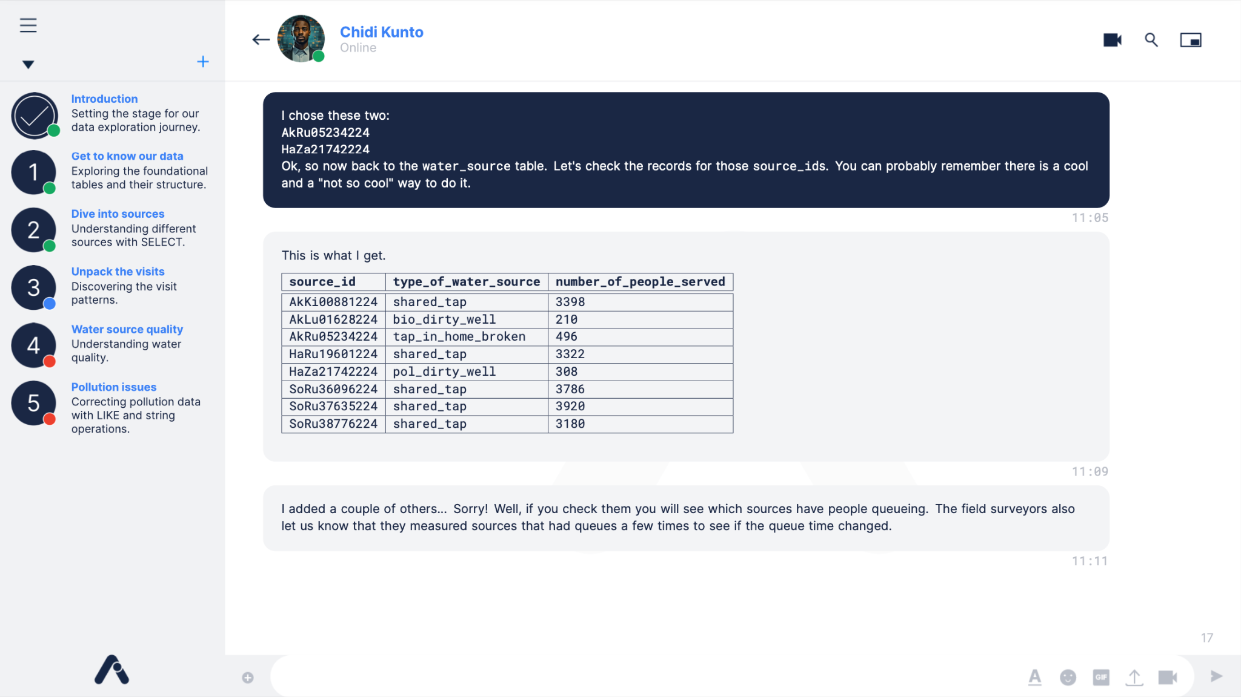

Project instructions format
Maji Ndogo: From analysis to action
The format of the slides that guide us through the project each week mimics a chat-like interface, similar to Google Chat.

Slide 9
Project instructions format
Maji Ndogo: From analysis to action
The format of the slides that guide us through the project each week mimics a chat-like interface, similar to Google Chat.
Chidi Kunto is our best virtual data analyst, who will help to break down tasks from President Naledi into more technical data questions.
Chidi represents a role model for an analyst. He is a good leader, passionate about the work he does, and critically thinks about everything.

Slide 10
Project instructions format
Maji Ndogo: From analysis to action
These status icons indicate progress. As we complete sections, the status icons turn green.
The current task we’re working on is shown in blue, and tasks yet to come are still in red.

Slide 11
Project instructions format
Maji Ndogo: From analysis to action
The story, tasks, code blocks, and query results are shared by Chidi in this space.

Slide 12
Project instructions format
Maji Ndogo: From analysis to action
The timestamps on these messages are unique. We can reference these like page numbers when collaborating or when asking questions.

Slide 13
Format
Maji Ndogo: From analysis to action
The story of Maji Ndogo’s struggle is told in grey chat bubbles.
The tasks we should do are highlighted in dark blue.
These are the queries we need to create to get the result sets Chidi shares throughout the project.

Slide 14
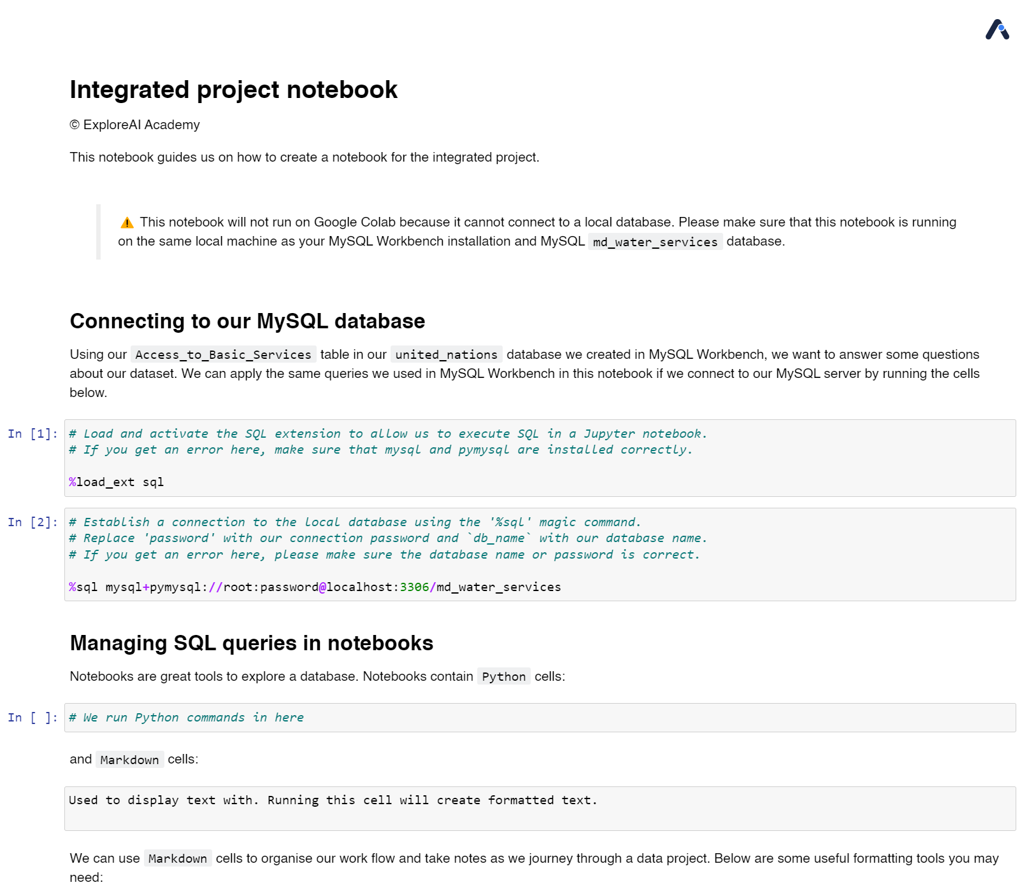
Managing SQL queries in MySQL Jupyter notebooks
Maji Ndogo: From analysis to action
Jupyter notebooks offer an interactive environment that's perfect for data projects, especially when working with SQL databases.
We can write SQL queries, execute them, and store the results of those queries – all in one place.
We can create notebooks in Jupyter to organize our work, summarize our findings, make some notes, and store results so that we can reference them later.
An example notebook is available for Part 1, but we encourage you to create these on your own for the rest of the project.

Slide 15



Our main goal
Maji Ndogo: From analysis to action
To make sure we’re the ones standing out in an interview, we should be able to solve any problem we’re given using our SQL skills.
Engaging with this project fully will help you to do that! So forget about the marks, and build your skills in SQL.
Several points in this project will be challenging, so we should rely on each other to learn. If you get stuck, reach out to your teammates and ask for help.

